Slide 1
Module-4
SVM-Hyperplanes , Classification using Hyperplanes , maximum margin hyperplanes in linearly separable data

Slide 2
Support Vector Machine-Hyperplanes
A Support Vector Machine (SVM) can be imagined as a surface that defines a boundary between various points of data which represent examples plotted in multidimensional space according to their feature values.
The goal of an SVM is to create a flat boundary, called a hyperplane , which leads to fairly homogeneous partitions of data on either side.
SVMs can be adapted for use with nearly any type of learning task, including both classification and numeric prediction.
SVMs are most easily understood when used for binary classification, which is how the method has been traditionally applied.

Slide 3
Classification with hyperplanes
SVMs use a linear boundary called a hyperplane to partition data into groups of similar elements, typically as indicated by the class values.
For example, the following figure depicts a hyperplane that separates groups of circles and squares in two and three dimensions.
Because the circles and squares can be divided by the straight line or flat surface, they are said to be linearly separable.
SVMs can also be extended to problems were the data are not linearly separable.
The task of the SVM algorithm is to identify a line that separates the two classes.

Slide 4
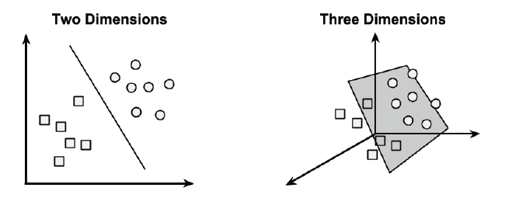

Slide 5
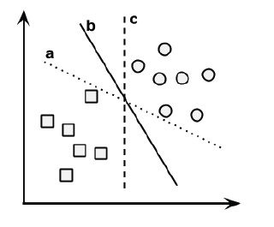
Finding maximum margin hyperplanes in linearly separable data
As shown in the above figure, there is more than one choice of dividing line between the groups of circles and squares. Three such possibilities are labeled a, b, and c.
How does the algorithm choose?

Slide 6
The answer to that question involves a search for the Maximum Margin Hyperplane (MMH) that creates the greatest separation between the two classes.
Although any of the three lines separating the circles and squares would correctly classify all the data points, it is likely that the line that leads to the greatest separation will generalize the best to future data.
The support vectors (indicated by arrows in the figure that follows) are the points from each class that are the closest to the MMH; each class must have at least one support vector, but it is possible to have more than one.
Using the support vectors alone, it is possible to define the MMH.

Slide 7
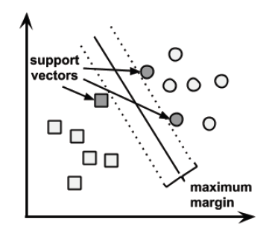
It is easiest to understand how to find the maximum margin under the assumption that the classes are linearly separable. In this case, the MMH is as far away as possible from the outer boundaries of the two groups of data points. These outer boundaries are known as the convex hull. The MMH is then the perpendicular bisector of the shortest line between the two convex hulls.

Slide 8
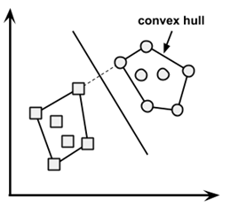

. In n-dimensional space, the following equation is used:

Slide 9

Using this formula, the goal of the process is to find a set of weights that specify two hyperplanes, as follows:
We will also require that these hyperplanes are specified such that all the points of one class fall above the first hyperplane and all the points of the other class fall beneath the second hyperplane. This is possible so long as the data are linearly separable.

